Slide 1

STANLEY COLLEGE OF ENGINEERING AND TECHNOLGY FOR WOMEN
(AUTONOMOUS), Abids. Hyderabad - 500 001
(Affiliated to Osmania University & Approved by AICTE)
(All eligible UG Courses are accredited by NBA & Accredited by NAAC with 'A' Grade)
Department of CSE B.E in Computer Science and Engineering
Academic Year: 2024-2025
Title : Comparative Analysis of 4 Machine Learning Models for Software Bug Prediction Using the JM1 Dataset
PRESENTED BY Haniya Shaik (160622733116)
Under the Guidance of Mrs. Shaheda Begum Assistant Professor
Department of Computer Science and Engineering

Slide 2
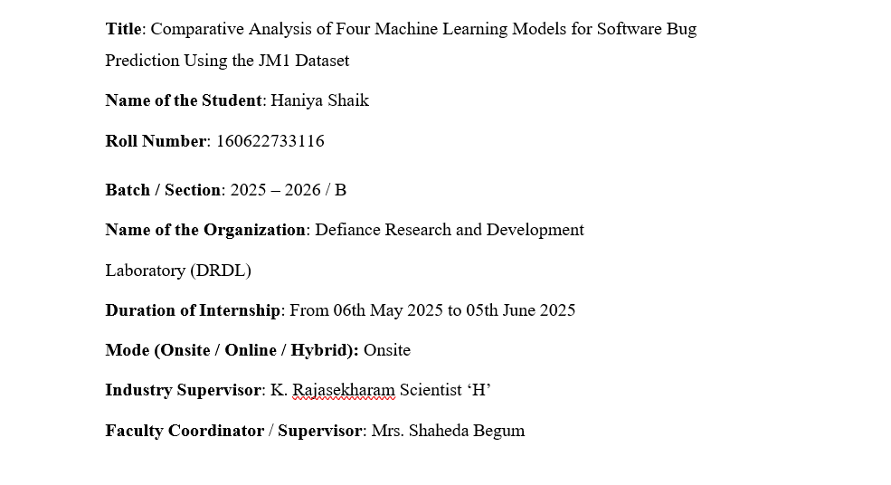
Internship Details

Slide 3
Contents
Abstract
Problem Statement
Background and Literature / Technology Review
Planning and Design of Work
Implementation and Execution
Testing and Validation
Results and Analysis
Challenges and Solutions
Conclusion and Future Scope
References
Internship Certificates

Slide 4
Abstract
This internship focused on applying Artificial Intelligence and Machine Learning techniques to improve software reliability through accurate bug prediction. Using NASA’s JM1 dataset, four supervised learning models—Logistic Regression, Decision Tree, Random Forest, and SVM—were developed, trained, and compared to identify defect-prone software modules. The work involved dataset preprocessing, balancing using SMOTE, model optimization, and evaluation through accuracy, precision, recall, and F1-score metrics. Random Forest delivered the strongest performance, proving its effectiveness for complex and high-dimensional data. The study demonstrated how AI-driven prediction can reduce maintenance costs, prevent failures, and support decision-making in defence software systems. Throughout this internship, I gained hands-on experience in Python-based data analysis, model evaluation, and visualization techniques. It also strengthened my understanding of supervised learning workflows, highlighted the importance of clean and balanced datasets, and improved my ability to compare algorithms objectively. Overall, the internship enhanced both my technical confidence and my awareness of how intelligent systems contribute to building reliable, efficient, and secure modern software solutions.

Slide 5
Problem Statement
To research and compare multiple machine learning algorithms for software bug prediction.
To work with real-world datasets, specifically the NASA JM1 dataset, used in defect analysis.
To evaluate supervised ML models like Logistic Regression, Decision Tree, Random Forest, and SVM.
To identify the most accurate and reliable model for predicting defect-prone software modules.
To support DRDL by improving software reliability, reducing maintenance costs, and enhancing defect detection accuracy
To bridge the gap between theoretical ML concepts and their practical use in defence-oriented software quality assurance.

Slide 6
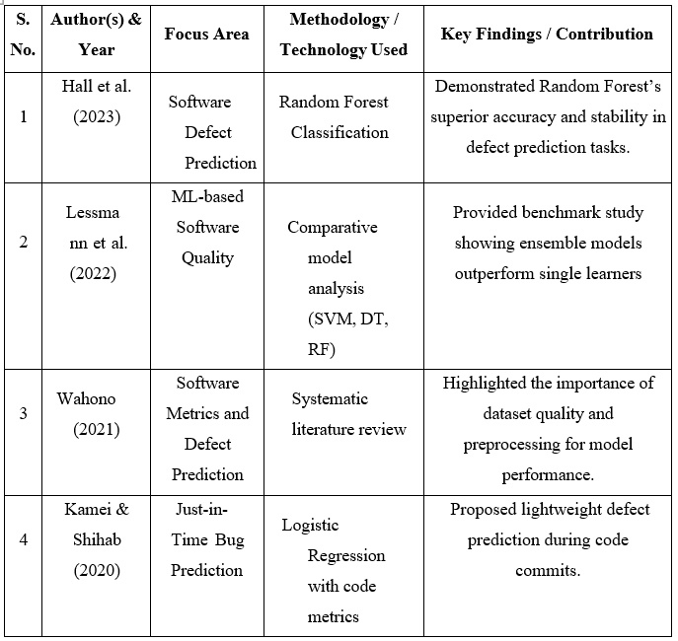
Background and Literature Review

Slide 7
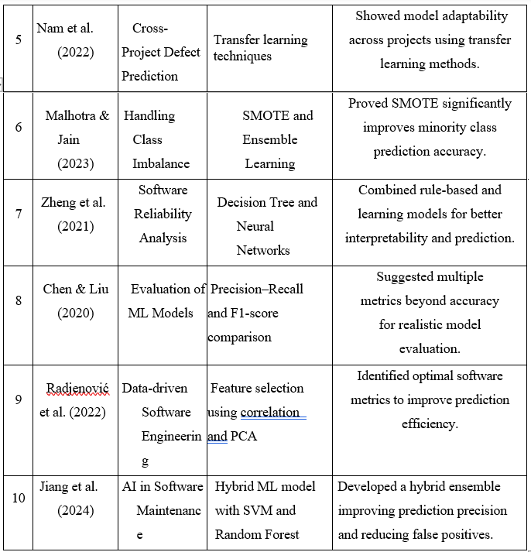
Background and Literature Review

Slide 8
Technology Review
Technology | Models | Why It Was Important
Machine Learning (ML) | Predict software defects using models | Automates defect detection & improves reliability
JM1 Dataset (NASA) | Real-world defect dataset for training models | Provides authentic data for accurate prediction
Logistic Regression | Base model for binary classification | Simple, interpretable, good for comparison
Decision Tree | Rule-based predictive model | Helps understand defect patterns clearly
Random Forest | Ensemble model combining multiple trees | Gives higher accuracy & handles imbalance
Support Vector Machine (SVM) | High-margin classifier | Performs well on complex defect data
SMOTE | Oversampling technique for class imbalance | Ensures fair training & better accuracy
pandas & NumPy | Data cleaning and preprocessing | Required for handling large defect datasets
Python & scikit-learn | Model building, training & evaluation | Simplifies ML workflow & boosts efficiency

Slide 9
Planning and Design of Work
Internship Plan & Timeline
Duration: 6 Weeks (May–June 2025)
Week-wise Plan:
Week 1: Orientation & Literature Review
Week 2: Dataset Preparation
Week 3: Model Development
Week 4: Evaluation & Analysis
Week 5: Documentation & Reporting

Slide 10
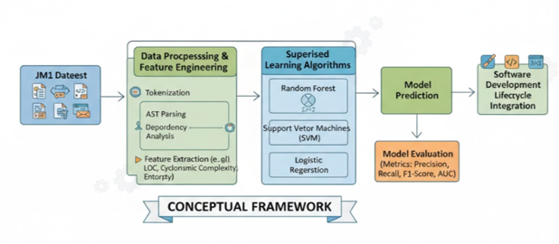
Planning and Design of Work
Workflow of the System
Conceptual Framework
Starts with the JM1 dataset containing software metrics.
Data is cleaned and processed (tokenization, feature extraction, etc.).
Processed data is given to ML models like Random Forest, SVM, and Logistic Regression.
Models perform bug prediction.
Performance is checked using Accuracy, Precision, Recall, F1-Score.
The best model can be used in the software development process to improve reliability.

Slide 11
About the Project
This project focuses on analyzing and comparing the performance of four different machine learning models for predicting software bugs in source code. The primary objective is to identify which model provides the highest accuracy and reliability in detecting potential defects early in the software development lifecycle. The dataset used for this study includes various software metrics such as lines of code, code complexity, coupling, cohesion, and past defect history. These features help in training models to classify modules as buggy or non-buggy.
Four popular models—Logistic Regression, Decision Tree, Random Forest, and Support Vector Machine (SVM)—were implemented and evaluated based on performance metrics like accuracy, precision, recall, F1-score, and ROC-AUC. Each model was trained and tested on the same dataset to ensure fair comparison. The analysis revealed that ensemble-based methods like Random Forest generally outperform individual models due to their ability to reduce overfitting and capture complex feature interactions.
This project demonstrates how predictive analytics can assist software engineers and quality assurance teams in proactively identifying high-risk modules, reducing testing costs, and improving overall software quality. It provides valuable insights into the strengths and limitations of different machine learning approaches for defect prediction and highlights the importance of data-driven decision-making in software engineering.

Slide 12
Objectives of the Project
The main objective of this project is to develop and compare machine learning models that can accurately predict software bugs based on historical software metrics. The project aims to build a data-driven framework that helps identify defect-prone modules early in the software development lifecycle, thereby improving software reliability and reducing maintenance costs. Specifically, it focuses on implementing four machine learning models—Logistic Regression, Decision Tree, Random Forest, and Support Vector Machine (SVM)—and evaluating their performance using metrics such as accuracy, precision, recall, F1-score, and ROC-AUC. Through this comparative analysis, the project seeks to determine the most effective model for software bug prediction. Additionally, it aims to understand the influence of key software metrics like code complexity, coupling, and cohesion on defect occurrence. Ultimately, the project strives to assist developers and testers in prioritizing testing efforts, enhancing software quality, and promoting the use of intelligent, automated tools in software engineering.

Slide 13
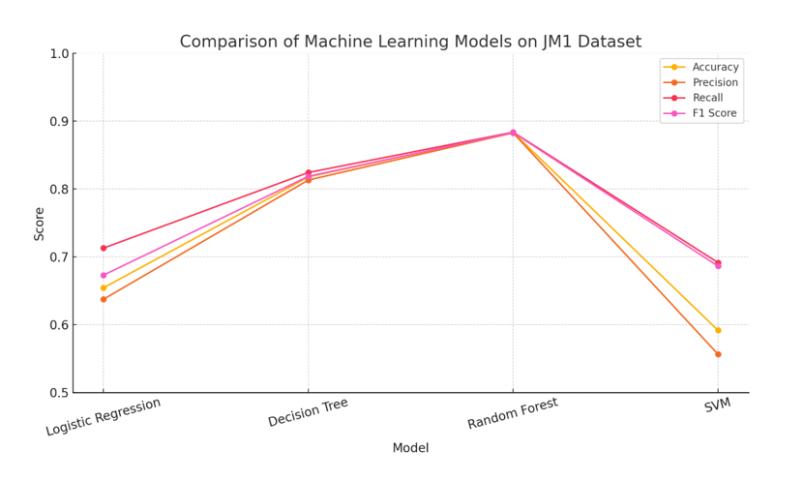
Graph Representation

Slide 14
Literature Survey
1 :Siswantoro M. Z. F., Yuhana U. L., “Software Defect Prediction Based on Optimized Machine Learning Models: A Comparative Study”, Teknika, 2022.
Problem Taken | Predicting software defects (bug-prone modules) using ML
Applied Algorithm/Methodology | k-Nearest Neighbours (k-NN), Decision Tree, Logistic Regression, Linear Discriminant Analysis (LDA), Single Hidden-Layer MLP, SVM — with hyperparameter tuning + PCA + SMOTE
Data Set | NASA MDP datasets (public)
Performance Measures | Accuracy (classification accuracy)
Improvements | Use of PCA + hyperparameter tuning improved over baseline models
Limitations | Performance varies by dataset; logistic regression & LDA underperformed

Slide 15
Literature Survey
2 :Gautam S., Khunteta A., Ghosh D., “Comparison of Machine Learning Models for Effective Software Fault Detection”, International Journal of Intelligent Systems and Applications in Engineering, 2023.
Problem Taken | Bug/defect prediction in software modules (open-source)
Applied Algorithm/Methodology | Decision Tree, Naïve Bayes, KNN, SVM, Random Forest
Data Set | PROMISE repository (KC2 dataset)
Performance Measures | Accuracy, Precision, Recall
Improvements | Comparative insight showing NB and SVM strong performers
Limitations | Only KC2 dataset used; may not generalize across projects.

Slide 16
Literature Survey
3 :Goyal J., Sinha R. R., “Machine Learning-Based Defect Prediction for Software Efficiency”, International Journal of Intelligent Systems and Applications in Engineering, 2023.
Problem Taken | Predicting defects (fault-prone modules) in software
Applied Algorithm/Methodology | SVM, Random Forest, Naïve Bayes, Logistic Regression, Artificial Neural Network
Data Set | JM1, KC1, KC2, PC1, DS1 (public)
Performance Measures | Accuracy, possibly F1-score
Improvements | ANN achieved highest accuracy (~93.8%) on these datasets
Limitations | Focus on publicly available datasets; mobile-app specific contexts limited

Slide 17
Literature Survey
4 :Khalid A., Badshah G., Ayub N., Shiraz M., Ghouse M., “Software Defect Prediction Analysis Using Machine Learning Techniques”, Sustainability, 2023
Problem Taken | Bug prediction in software modules using ML + optimization & clustering
Applied Algorithm/Methodology | K-means clustering (for class label grouping) + classification models (SVM, NB, RF) + Particle Swarm Optimization (PSO)
Data Set | PROMISE repository (CM1 dataset and others)
Performance Measures | Precision, Accuracy, Recall, F-measure, confusion matrix
Improvements | Optimization (PSO) plus clustering improved performance; SVM (optimized) achieved ~99%
Limitations | Limited dataset size; claim that larger diverse datasets needed for validation

Slide 18
Literature Survey
5 :Harshal Shah & Prashant Sahatiya, “A Comparative Analysis Study of Software Defect Prediction using Machine Learning Algorithms on NASA Dataset”, Journal of Harbin Institute of Technology, 2022.
Problem Taken | Bug/defect prediction in software modules using ML
Applied Algorithm/Methodology | SVM, Decision Tree, Random Forest, Linear Regression, Naïve Bayes, K-NN
Data Set | NASA / PROMISE datasets: JM1, CM1 and PC1
Performance Measures | Accuracy (and comparative results)
Improvements | Demonstrated which ML algorithms yield higher accuracy on these datasets for defect prediction
Limitations | Only three datasets used; may not generalise across many software systems

Slide 19
Literature Survey
6 :Aimen Khalid, Gran Badshah, Nasir Ayub, Muhammad Shiraz & Mohamed Ghouse, “Software Defect Prediction Analysis Using Machine Learning Techniques”, Sustainability, 2023
Problem Taken | Software defect prediction; improving model performance via optimization
Applied Algorithm/Methodology | K-means clustering (for class label grouping) + SVM, NB (Naïve Bayes), Random Forest (RF) + Particle Swarm Optimization (PSO) for optimizing models
Data Set | Public software defect datasets (software metrics)
Performance Measures | Precision, Accuracy, Recall, F-measure, Confusion Matrix
Improvements | Optimized SVM achieved very high accuracy (~99%); clustering + PSO improved classifier performance
Limitations | High accuracy possibly due to dataset characteristics; further validation needed on more diverse datasets

Slide 20
References
1.Dataset: https: https://github.com/selva86/datasets/blob/master/JM1.csv
2.SMOTE Documentation: https://imbalanced-learn.org/stable/references/generated/imblearn.over_sampling. SMOTE.html
3.pandas Library: https://pandas.pydata.org/
4.Random Forest Paper: https://link.springer.com/article/10.1023/A:1010933404324
5.Logistic Regression Basics: https://towardsdatascience.com/logistic-regression-detailed-overview-46c4da4303bc
6.Decision Tree Theory: https://www.saedsayad.com/decision_tree.htm
7.SMOTE for Imbalanced Learning: https://www.jair.org/index.php/jair/article/view/10302
8.SVM Introduction: https://scikit-learn.org/stable/modules/svm.html

Slide 21
THANK YOU

